Slide 1
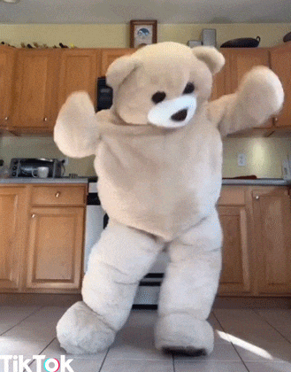
Team
Pacman
- Final Presentation -
Team Pacman | Foodiyo App | Final Presentation

Slide 2
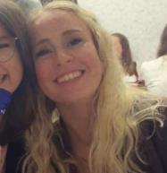
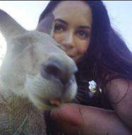
Team Pacman
*Julia
Human Factors
Engineering
*Chrissi
Human Factors
Engineering
Team Pacman | Foodiyo App | Final Presentation

Slide 3
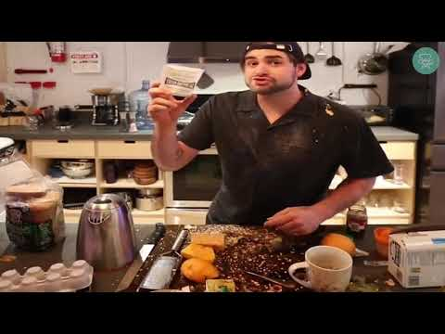
[12, 13]

Slide 4
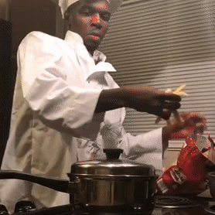
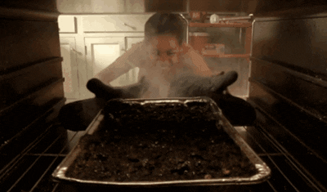
Interviews
"I always have a type of food in mind but cannot find the right recipe!"
- iteration 1 -
"Sometimes I am worried about not having all the ingredients at home!"
"I often buy ingredients when there are special offers & check what to prepare with it afterwards!"
[16]
"I am disappointed when a dish did not turn out well!"
"I am annoyed when I'm struggling to find a recipe!"
[15]
Team Pacman | Foodiyo App | Exploration
4

Slide 5
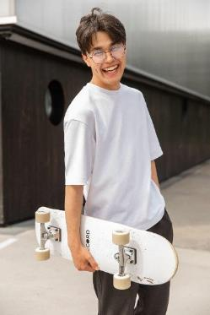
Daniel PERSONA
AGE: 24 OCCUPATION: Working Student STATUS: Single LOCATION: Munich EDUCATION: Informatics M.Sc. HOBBIES: Skateboard, . Tennis, Soccer
NEEDS - Get relevant recipes based on ingredients he chooses - Quick & easy cooking - Get suggestions on dishes - Healthy dishes - Appealing pictures of dish
GOALS - Having fun while cooking - Improve cooking skills - Cook for family & friends
FEARS - No clue how & what to cook - Worried about not having all the ingredients at home
[14]
“I cook because it’s fun to get hands-on with food and experiment with flavors”
Team Pacman | Foodiyo App | Exploration
5
https://www.pexels.com/de-de/foto/freudiger-ethnischer-mannlicher-teenager-der-skateboard-tragt-und-nach-dem-training-im-park-lacht-5384429/

Slide 6
How might we support people in finding recipe inspirations with ingredients they already have at home
to prepare great dishes?
Team Pacman | Foodiyo App | Exploration

Slide 7
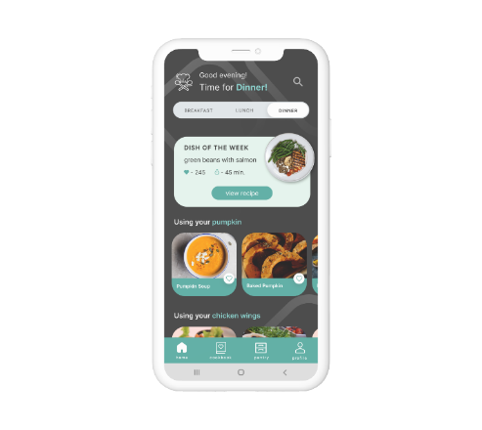
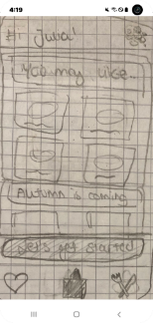
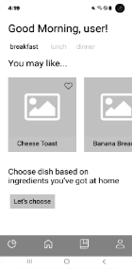
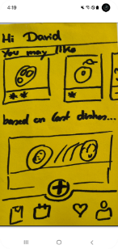
Design Iterations…
*Figma Lo-Fi prototype (iteration 1-2)
*HTML / CSS / JS Hi-Fi prototype (iteration 3-5)
*pen & paper prototype (iteration 1)
*pen & paper prototype (iteration 1)
Team Pacman | Foodiyo App | Prototyping

Slide 8
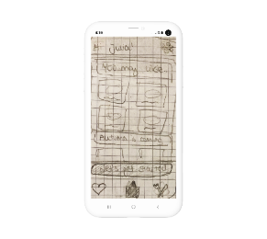
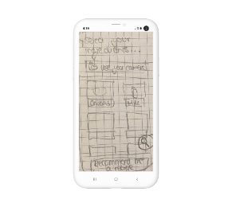
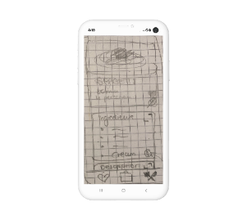
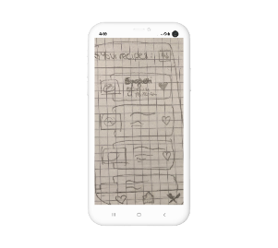
Prototyping Process
- iteration 1 -
first sketches to come up with a proper user flow
user tests using the "Thinking-aloud" method [8]
user feedback:
intuitive user flow
onboarding process too cumbersome
Team Pacman | Foodiyo App | Prototyping - iteration 1

Slide 9
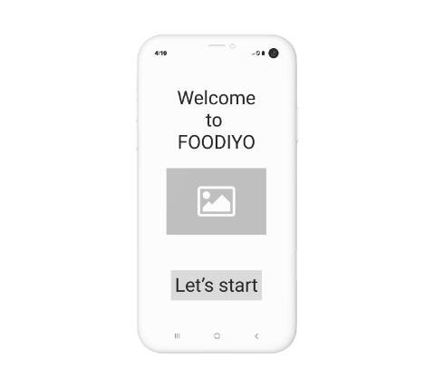
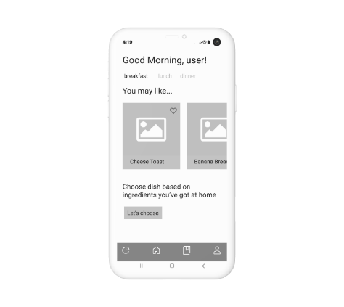
Prototyping Process
- iteration 1 -
Created a low-fidelity prototype by using Figma
Users were not convinced about the app design
more colors & pictures
modern app design
function for adding ingredients is too hidden
*Figma prototype (iteration 1-2)
Team Pacman | Foodiyo App | Prototyping - iteration 1

Slide 10
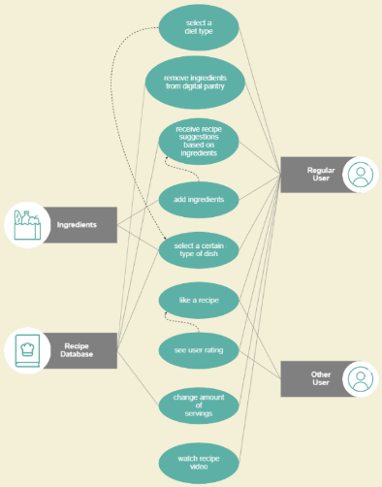

Prototyping Process
- iteration 2 -
Created an UML use-case diagram to capture the requirements of the application [10]
High level functions: - add / remove ingredients - select a diet type - like a recipe & save it
*UML use-case diagram
Team Pacman | Foodiyo App | Prototyping - iteration 2
Notes:
In software engineering, a class diagram in the Unified Modeling Language (UML) is a type of static structure diagram that describes the structure of a system by showing the system's classes, their attributes, operations (or methods), and the relationships among objects.

Slide 11
Prototyping Process
Flexibility & efficiency of use
- iteration 2 -
Consistency and standards
Most important design principles [11]:
Aesthetic and minimalist design
Flexibility & efficiency of use
Maintain consistent standards so users know what to do next without having to learn new tool sets.
Match between system and real world
Aesthetic and minimalist design
Visibility of the system status
Team Pacman | Foodiyo App | Prototyping - iteration 2

Slide 12
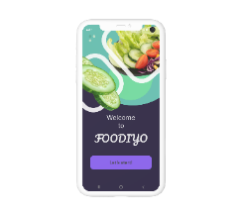
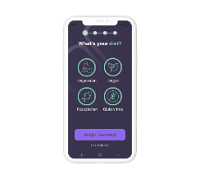
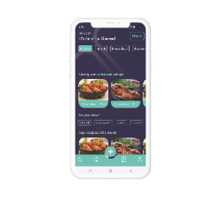
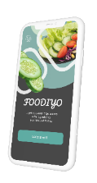
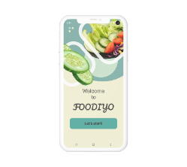
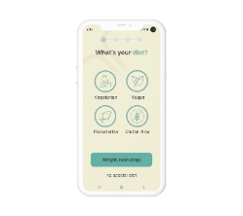
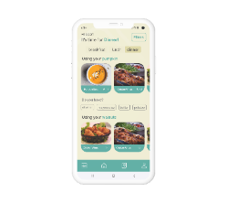
Prototyping Process
- iteration 2 -
A/B Testings: asked for feedback on different color schemes & design approaches [5, 9].
Due to the user feedback we decided for the following color scheme & design.
Team Pacman | Foodiyo App | Prototyping - iteration 2

Slide 13
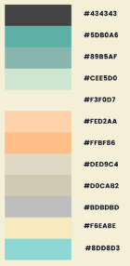
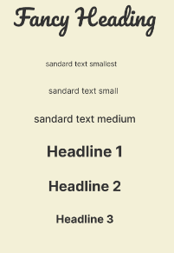

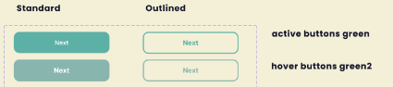
color scheme
font sizes
Prototyping Process
- iteration 2 -
Own customized design language based on user feedback
Calculation of the minimum font size based on the following equation [7]:
→ minimum: 7pt
→ recommended: 10pt
buttons
Team Pacman | Foodiyo App | Prototyping - iteration 2

Slide 14
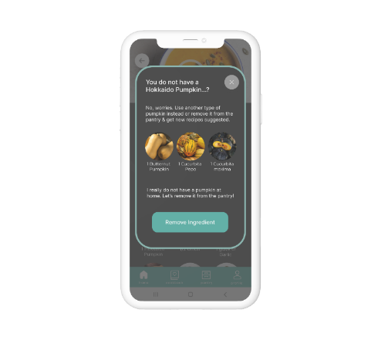
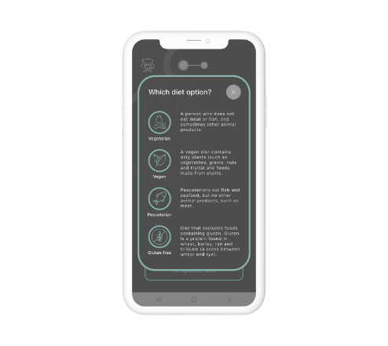
Prototyping Process
- iteration 3 -
Added “help screens” which should support in getting information about a specific function, because during our interviews we got the feedback that these screens were missing.
*info: removing ingredients
*info: diet options
Team Pacman | Foodiyo App | Prototyping - iteration 3

Slide 15
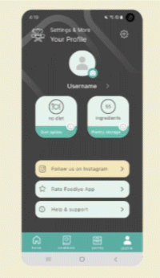

Prototyping Process
- iteration 3 -
Created a user section where the user can set personal preferences (e.g. change diet type & user name)
*profile section
Team Pacman | Foodiyo App | Prototyping - iteration 3

Slide 16
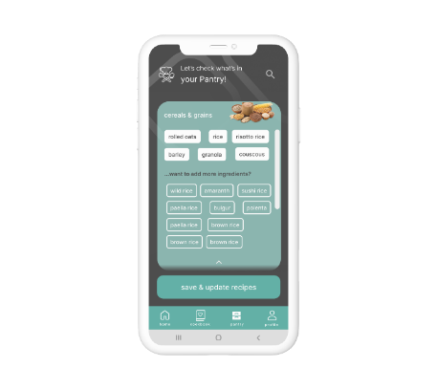
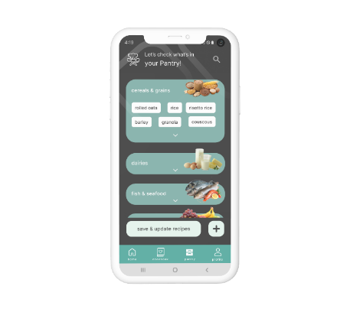
BEFORE
Prototyping Process
- iteration 4 -
Users were indicating that the pantry screen within the menu section looks way too crowded
Implemented an additional “plus-button” to add more ingredients to the digital pantry
*before
*after
Team Pacman | Foodiyo App | Prototyping - iteration 4

Slide 17
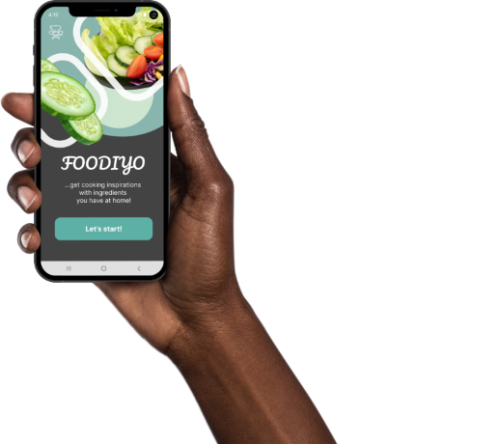
Live Presentation
Let’s start
*HTML / CSS / JS prototype
Team Pacman | Foodiyo App | HiFi Web App - Live Presentation
Notes:
https://interactionprototyping.github.io/WS2022_Pacman/v4/

Slide 18
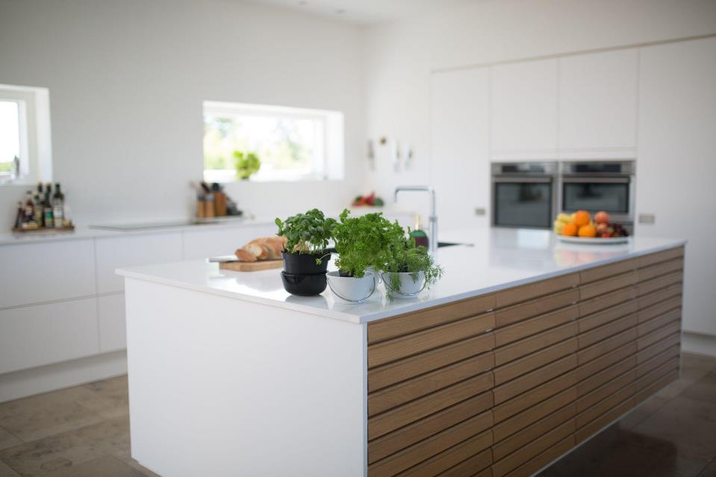
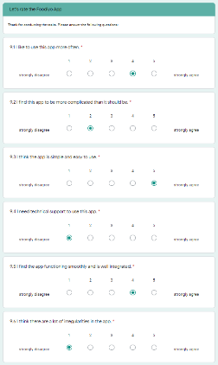
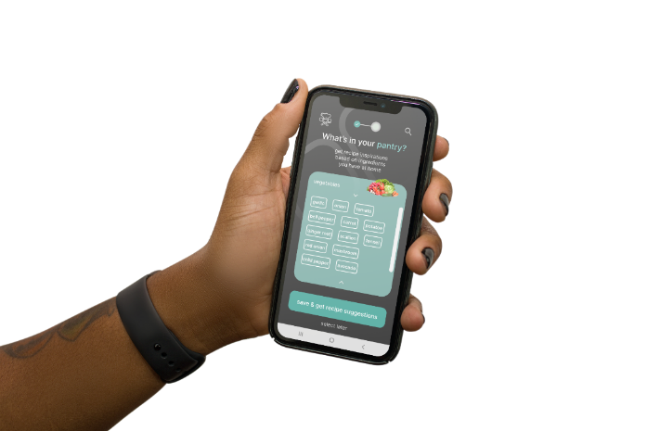
Quantitative Evaluation
- iteration 5 -
Team Pacman | Foodiyo App | Evaluation- iteration 5

Slide 19
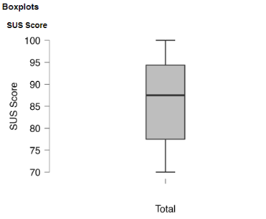

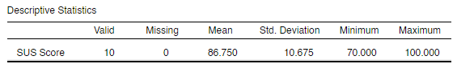
Quantitative Evaluation
- iteration 5 -
Subjects do exceed a SUS-Score of 70 regarding the complete application [1,2,4].
This value reflects an adjective rating of "excellent" [4].
Figure 1: Boxplot and descriptive statistics of the System Usability Scale (SUS)
Team Pacman | Foodiyo App | Evaluation - iteration 5

Slide 20
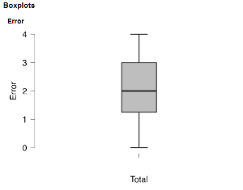
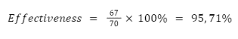
Quantitative Evaluation
- iteration 5 -
Subjects do not make more than 4 errors when conducting the tasks [1,2,5,6].
Subjects complete tasks 1-5 with a completion rate of 78% [2,3].
The average Task Level Satisfaction does exceed a value of 5 [6].
Figure 2: Boxplot of the errors made during the user tests
Figure 3: Calculation of effectiveness
Team Pacman | Foodiyo App | Evaluation - iteration 5

Slide 21

Qualitative Evaluation
- iteration 5 -
“I would love to have a auto-complete function!”
“I weren’t able to find the recipe video….”
“I would like to adjust the amounts when entering my ingredients!”
“Shouldn’t there be a “heart icon” in the navigation bar?”
“Some buttons should be highlighted a bit more”
“It would be great to get a notification after adding the recipe to the favorites”
Team Pacman | Foodiyo App | Outlook
Notes:
Implications for further Improvements

Slide 22
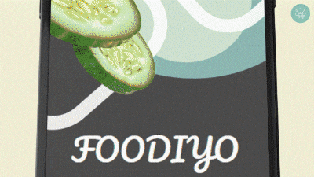
Thank you for your attention!
Team Pacman | Foodiyo App | Final Presentation

Slide 23
References
[1] Nielsen, Jakob. (1993). Usability Engineering. chapters 6.7, 6.8, 7.1, 7.2
[2] Sauro, Jeff. (2010). A Practical Guide to Measuring Usability.
[3] “10 Things To Know About Completion Rates”, https://measuringu.com/completion-rates/, access on 18.01.2022
[4] Aaron Bangor, Philip T. Kortum & James T. Miller (2008) An Empirical Evaluation of the System Usability Scale, International Journal of Human–Computer Interaction, 24:6, 574-594, DOI: 10.1080/10447310802205776
[5] Don, Norman (2013). The Design of Everyday Things
[6] “Usability Metrics – A Guide To Quantify The Usability Of Any System”, https://usabilitygeek.com/usability-metrics-a-guide-to-quantify-system-usability/, access on 17.01.2022
[7] DIN EN ISO 9241-303
[8] Lewis, Clayton. (1982). Using the "Thinking-aloud" Method in Cognitive Interface Design. S.1-6
[9] Morris, Jason. (2021). Hands-On Android UI Development: Design and develop attractive user interfaces for Android applications.
[10] Leffingwell, Dean. Widrig, Don. (2003) Managing Software Requirements: A Use Case Approach (UML)
[11] https://www.interaction-design.org/literature/topics/design-principles, access on 17.01.2022 [12] Final Presentation | Team Pacman | Foodiyo App [Video]. YouTube. https://youtu.be/LY3ywMwHyUM [13] https://youtu.be/LY3ywMwHyUM, access on 17.01.2022
[14] https://www.pexels.com/de-de/foto/freudiger-ethnischer-mannlicher-teenager-der-skateboard-tragt-und-nach-dem-training-im-park-lacht-5384429/, access on 17.01.2022
[15] https://giphy.com/gifs/hulu-cbs-everybody-hates-chris-3o7TKUslwxnKHz0axa, access on 17.01.2022
[16] https://giphy.com/gifs/make-chef-fries-102xzU5V7M1YOs, access on 17.01.2022
Team Pacman | Foodiyo App

